Slide 1
ITM7000 Master project
Dr. Qizhen Gu (Kimi)

Slide 2
RESEARCH PAPER
Chapter 1: introduction
Chapter 2 : Literature review
Chapter 3 Research framework
Chapter 4 Research methodology
Chapter 5 Research result
Chapter 6 Discussion and recommendation

Slide 3
Chapter 5 Research result
5.1 Reliability testing
5.2 Descriptive analysis
5.3 Mean and Standard Deviation for Descriptive Analysis
5.4 Hypothesis Testing Results

Slide 4
5.1 Reliability testing
Cronbach's α. If it is ≥0.7, the questionnaire with this variable has no problem.
If this value is < 0.7, it indicates that the questionnaire does not have sufficient reliability.
There are various methods for remediation.
First, look for references. Some literatures emphasize that a value of Cronbach's α ≥0.6 meets the requirements.
Secondly, data can be collected again and tested again.
Thirdly, you can look at the table within the red box. Here it shows what the value of Cronbach's α will become if a certain problem is removed.

Slide 5
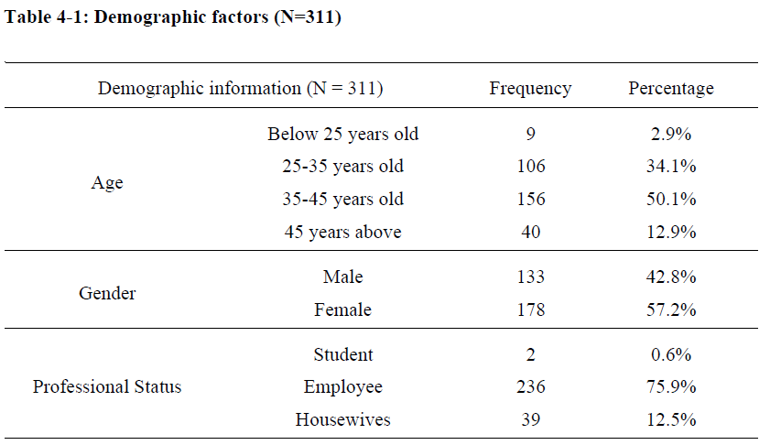
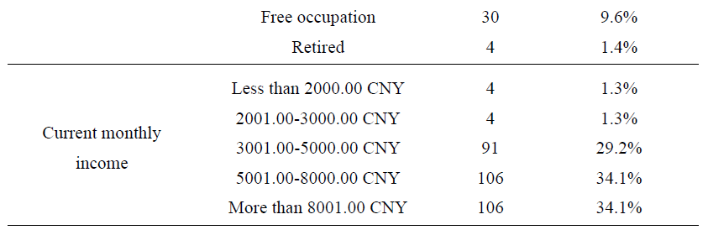
5.2 Descriptive analysis
Present descriptive statistics (frequencies, percentages) for demographic data (e.g., gender, age, education, position).
Use tables or charts for clarity.

Slide 6
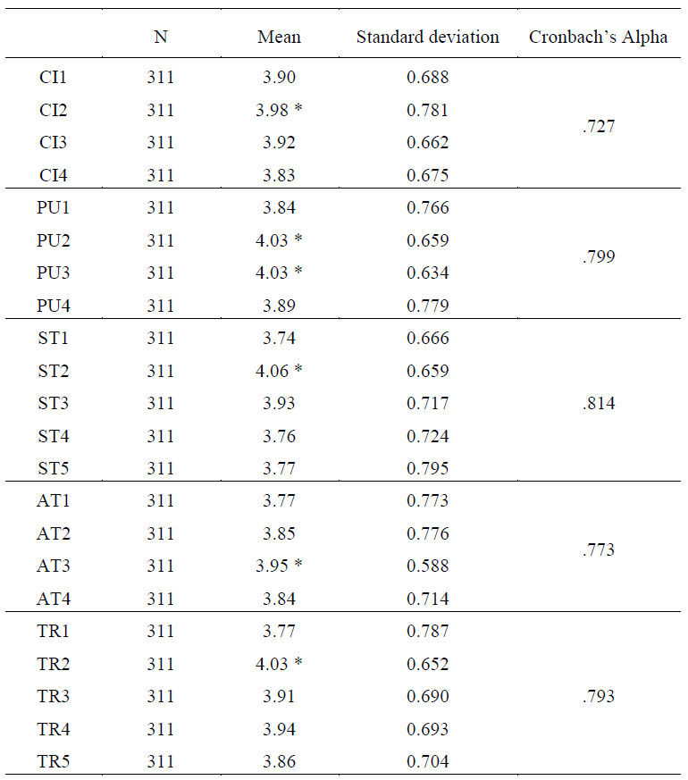
5.3 Mean and Standard Deviation for Descriptive Analysis
Report means, standard deviations, and other relevant descriptive statistics for each study variable. (we also can combine the Cronbach’s Alpha in the table)
The mean can help with us when we make recommendation

Slide 7
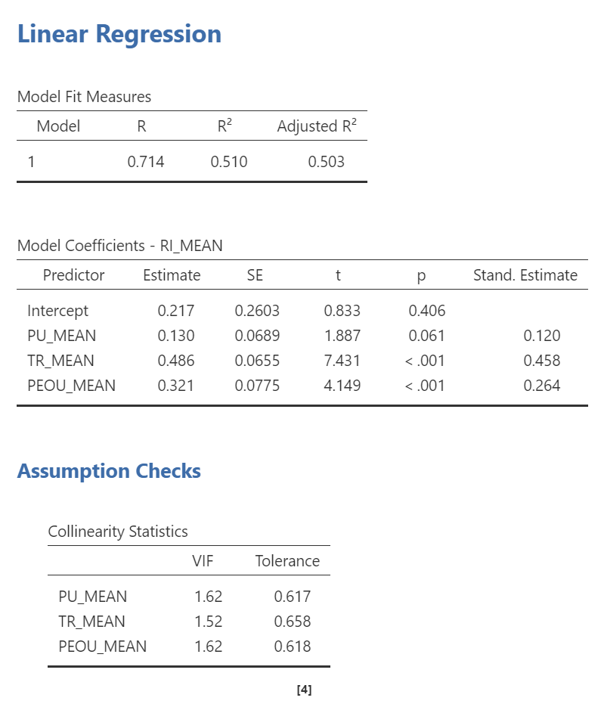
5.4 Hypothesis Testing Results

Slide 8
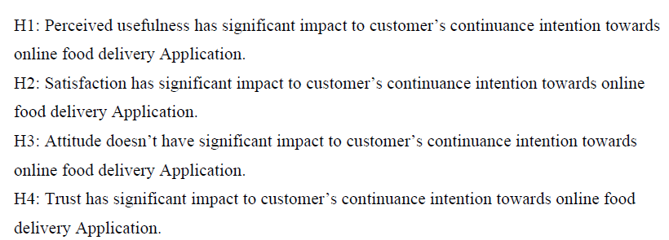

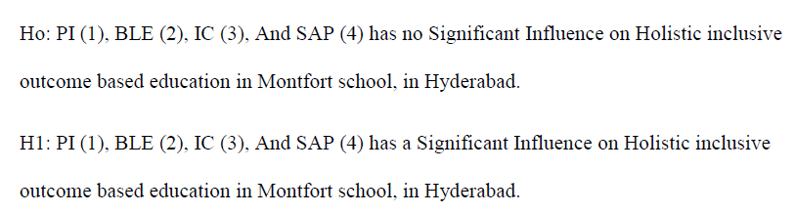
5.4 Hypothesis Testing Results
Report results for each research hypothesis (regression coefficients, p-values)
Clearly state whether each hypothesis is supported, using statistical evidence.
Use tables and figures to present key results (summary tables of regression, VIF table)

Slide 9
Additional Analyses (if any)
Report results of mediation (some of your research might use mediation analysis)

Slide 10
Chapter 6 Discussion and recommendation
6.1 Discussion and conclusion
6.2 Recommendations based on Finding
6.3 Future studies
References

Slide 11
6.1 Discussion and conclusion
For each research question or hypothesis, interpret the results:
Compare your findings with previous literature (agreements, contradictions).
Explain possible reasons for your results. (If the result is conflicted with previous study we need to explain why as the research designer. )
Highlight unexpected results or surprises.

Slide 12
6.2 Recommendations based on Finding
Theoretical Implications
Discuss how your findings contribute to existing theories or models.
Identify any new conceptual insights or extensions to current frameworks.
Practical Implications
Offer actionable recommendations for practitioners, managers, policymakers, or IT leaders (e.g., “Organizations should invest in digital skills training because…”).
Explain how results can improve current practice, strategies, or decision-making.

Slide 13
6.3 Future studies
Limitations of the Study
Acknowledge major limitations (methodological, sample, measurement, etc.).
Discuss how they may affect interpretation and generalizability.
Suggestions for Future Research
Propose ways to address limitations in future studies.
Recommend new questions, variables, or contexts for further exploration.

Slide 14
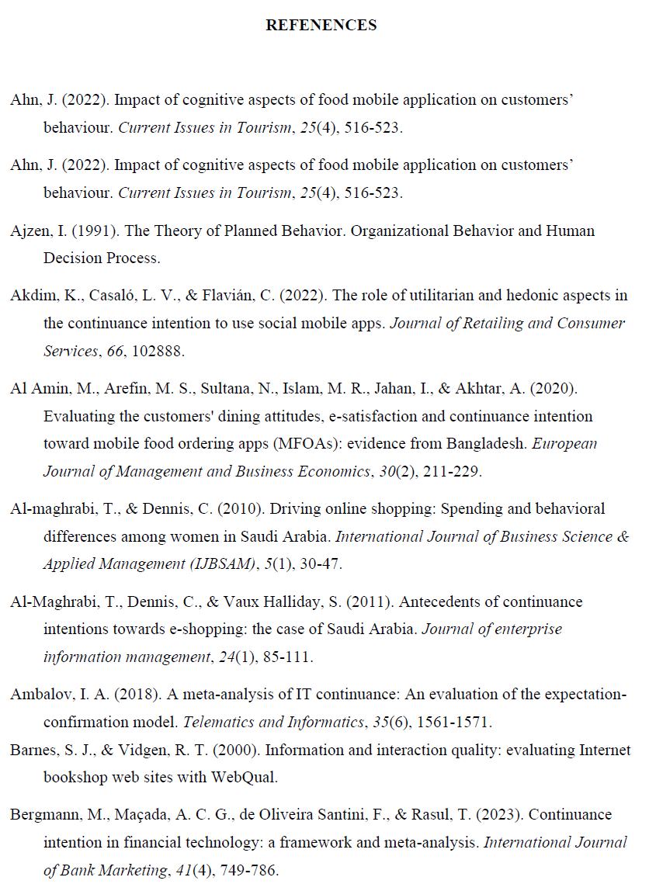
References

Slide 15
Thank you
Faculty member of ITM
guqizhen@au.edu

